Slide 1
Fundamental concepts of computer networks.
Lecture 1
1.<number>

Slide 2
1-1 DATA COMMUNICATIONS
The term telecommunication means communication at a distance. The word data refers to information presented in whatever form is agreed upon by the parties creating and using the data.
Data communications are the exchange of data between two devices via some form of transmission medium such as a wire cable or wireless.
Delivery → Correct destination
Accuracy → Accurate data
Timelines → Real-time transmission
Jitter → Uneven delay
1.<number>

Slide 3

Topics discussed in this section:
Components
Data Representation
Data Flow
Components
Figure 1.1 Five components of data communication
5
1
2
3
4
1.<number>

Slide 4

Data Representation
Text
Numbers
Images
Audio
Video
Data flow
Simplex
Half-duplex
Full-duplex
1.<number>

Slide 5
1-2 NETWORKS
A network is a set of devices (nodes) connected by communication links. A node can be a computer, printer, or any other device capable of sending and/or receiving data generated by other nodes on the network.
Topics discussed in this section:
Network Criteria (performance, reliability, and security)
Physical Structures ( type of connections and topologies)
Network Models
Categories of Networks ( LAN, MAN and WAN)
Interconnection of Networks: Internet
1.<number>

Slide 6
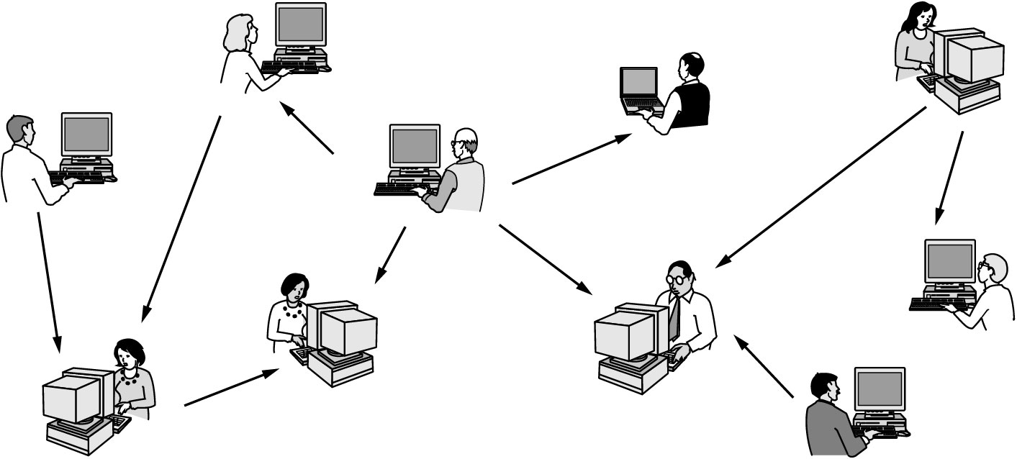
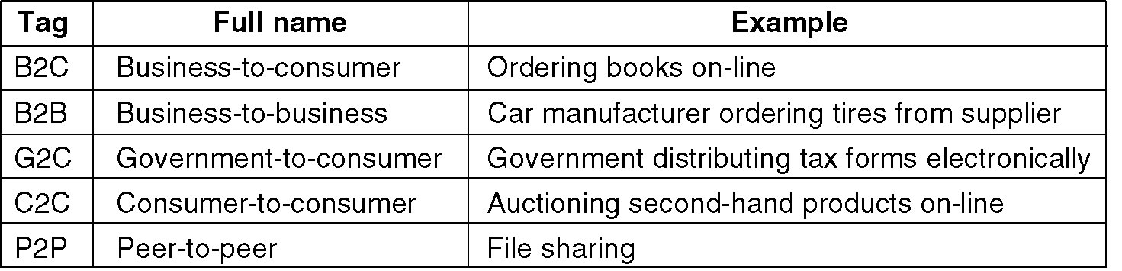
Why Computer Networks?
Application Type
Fall 2010
CEG 4188
1-<number>

Slide 7

1.<number>

Slide 8
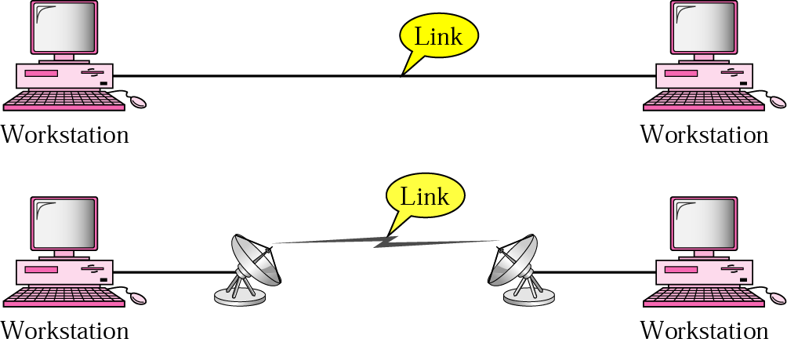
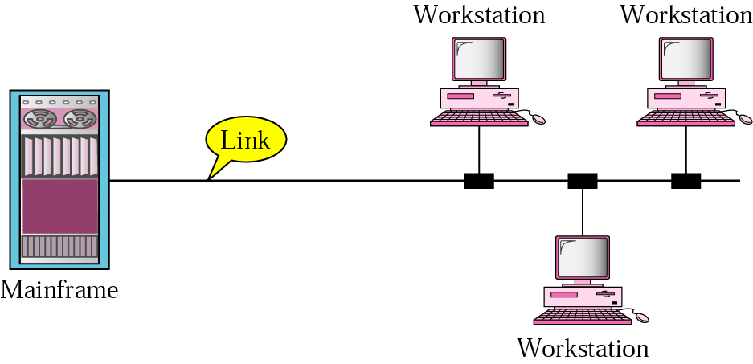
Types of connections
Point to point
  A dedicated link is provided between two devices
Multipoint
  More than two specific devices share a single link
1.<number>

Slide 9

Physical Topology
Tree
1.<number>

Slide 10
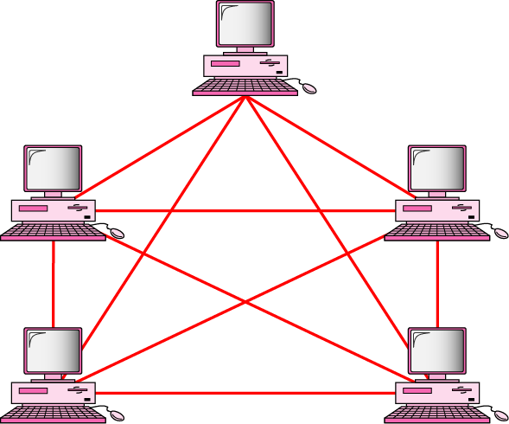
MESH Topology
Every device has a dedicated point-to-point link to every other devices
Dedicated
  Link carries traffic only between the two devices it connects
  A fully connected mesh network has n(n-1)/2 physical channels to link n devices
  Every device on the network must have n-1 input/output (I/O) ports
Advantage
  Less traffic, robust, secure, easy to maintain
Disadvantage
  Need more resource (cable and ports), expensive
n(n-1)/2 physical duplex links
1.<number>

Slide 11
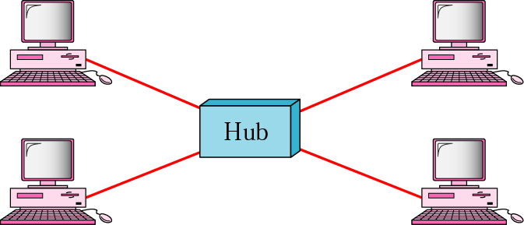
STAR Topology
Each device has a dedicated point-to-point link only to a central controller, usually called a hub.
No direct traffic and link between devices
Advantages
  Less expensive
  Easy to install and reconfigure
  Robustness
Disadvantage
  Single point of failure
1.<number>

Slide 12
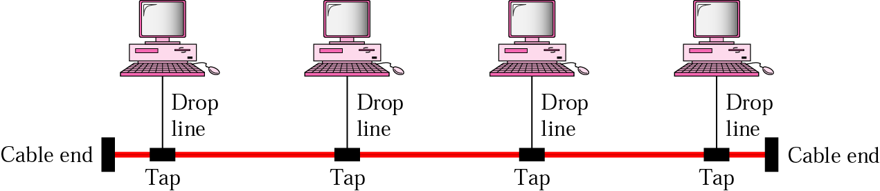
BUS Topology
A multipoint topology
All devices are linked through a backbone cable
Nodes are connected to the bus cable by drop lines and taps.
  Drop line
    A connection running between the device and the main cable
  Tap
    A connector that either splices into the main cable or punctures the sheathing of a cable to create a contact with the metallic core
Advantage:
  Ease of installation
  Disadvantages:
    Difficult reconnection and fault isolation
    Broken or fault of the bus cable stops all transmission
1.<number>

Slide 13

RING Topology
Each device is dedicated point-to-point connection only with the two devices on either side of it
A signal is passed along the ring in the direction, from device to device, until it reaches its destination
Each device in the ring incorporates a repeater
Advantages
  Relatively easy to install and reconfigure
  Fault isolation is simplified
Disadvantage
  Unidirectional traffic
1.<number>

Slide 14
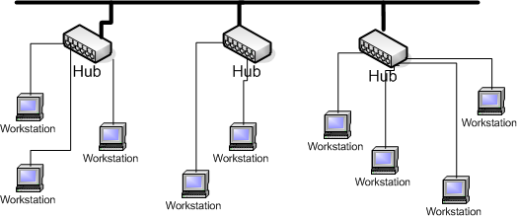
Tree Topology
Tree topologies integrate multiple topologies together
Example: Tree topology integrates multiple star topologies together onto a bus
Advantages:
  Point-to-point wiring for individual segments.
  Supported by several hardware and software venders.
Disadvantages:
  Overall length of each segment is limited by the type of cabling used.
  If the backbone line breaks, the entire segment goes down.
  More difficult to configure and wire than other topologies.
1.<number>

Slide 15

A hybrid topology: a star backbone with three bus networks
1.<number>

Slide 16

Categories of Networks
Local Area Network (LAN)
Wireless Local Area Network (WLAN)
Metropolitan Area Network (MAN)
Wide Area Network (WAN)
An isolated LAN connecting 12 computers to a hub in a closet
1.<number>

Slide 17
Classification According to Coverage Area
Local Area Networks (0-2 Km; campus)
    Ethernet (10/100/1000 Mbps), Token ring (4, 16 Mbps),
    IEEE 802.11(b, g, a, n)
Metropolitan Area Networks (2-50 km; corporate offices, city)
    DQDB (Distributed Queue Dual Bus), WiMAX
    (IEEE 802.16.a/b/e)
Wide Area Networks (country, continent)
    transmission lines, switching elements
  Personal Access Networks (PANs)
      Bluetooth, IEEE 802.15.3
Notes:
DIMITRIOS MAKRAKIS, SITE, U OF O

Slide 18

WANs: a switched WAN and a point-to-point WAN
1.<number>

Slide 19

Interconnection of Networks: internet
A heterogeneous network made of four WANs and two LANs
1.<number>

Slide 20
1-3 THE INTERNET
The Internet has changed many aspects of our daily lives. It has affected the way we do business as well as the way we spend our leisure time. The Internet is a communication system that has brought a wealth of information to our fingertips and organized it for our use.
Topics discussed in this section:
A Brief History → ARPANET
1967 ACM
1969 UCLA, UCSB, SRI, UoU
1972 TCP
The Internet Today (ISPs)
1.<number>

Slide 21

Hierarchical organization of the Internet
1.<number>

Slide 22
1-4 PROTOCOLS AND STANDARDS
protocols and standards.
Protocol is synonymous with rule.
Standards are agreed-upon rules.
Topics discussed in this section:
Protocols
Standards
Standards Organizations
Internet Standards
1.<number>

Slide 23
PROTOCOLS AND STANDARDS
Protocols
Syntax → format of the data
Semantics → meaning of each section
Timing → when data should be sent and how fast.
Standards
De facto → by fact (not approved as a standard)
De jure → by Law (approved)
1.<number>

Slide 24
PROTOCOLS AND STANDARDS
Standards Organizations
International Organization for Standardization (ISO)
International Telecommunication Union - Telecommunication Standards (ITU-T)
American National Standards Institute (ANSI)
Institute of Electrical and Electronics Engineers (IEEE)
Electronic Industries Association (EIA)
1.<number>

Slide 25
Network Models
Lecture 2
OSI Model
1.<number>

Slide 26
1-5 LAYERED TASKS
A network model is a layered architecture
  Task broken into subtasks
  Implemented separately in layers in stack
  Functions need in both systems
  Peer layers communicate
Protocol:
  A set of rules that governs data communication
  It represents an agreement between the communicating devices
1.<number>

Slide 27

Tasks involved in sending a letter
Topics discussed in this section:
Sender, Receiver, and Carrier
Hierarchy (services)
1.<number>

Slide 28
1-5.1 THE OSI MODEL
Established in 1947, the International Standards Organization (ISO) is a multinational body dedicated to worldwide agreement on international standards.
An ISO is the Open Systems Interconnection (OSI) model is the standard that covers all aspects of network communications from ISO. It was first introduced in the late 1970s.
1.<number>

Slide 29
ISO is the organization.
OSI is the model.
Topics discussed in this section:
Layered Architecture
Peer-to-Peer Processes
Encapsulation
1.<number>

Slide 30

Layered Architecture
Layers
Layer 7. Application
Layer 6. Presentation
Layer 5. Session
Layer 4. Transport
Layer 3. Network
Layer 2. Data Link
Layer 1. Physical
Seven layers of the OSI model
Sender
Receiver
1.<number>

Slide 31
Layered Architecture
A layered model
Each layer performs a subset of the required communication functions
Each layer relies on the next lower layer to perform more primitive functions
Each layer provides services to the next higher layer
Changes in one layer should not require changes in other layers
The processes on each machine at a given layer are called peer-to-peer process
1.<number>

Slide 32
PEER – TO – PEER PROCESS
Communication must move downward through the layers on the sending device, over the communication channel, and upward to the receiving device
Each layer in the sending device adds its own information to the message it receives from the layer just above it and passes the whole package to the layer just below it
At the receiving device, the message is unwrapped layer by layer, with each process receiving and removing the data meant for it
1.<number>

Slide 33
PEER – TO – PEER PROCESS
The passing of the data and network information down through the layers of the sending device and backup through the layers of the receiving device is made possible by interface between each pair of adjacent layers
Interface defines what information and services a layer must provide for the layer above it.
1.<number>

Slide 34

The interaction between layers in the OSI model
1.<number>

Slide 35

An exchange using the OSI model
1.<number>

Slide 36
LAYERS IN THE OSI MODEL
Topics discussed in this section:
Physical Layer
Data Link Layer
Network Layer
Transport Layer
Session Layer
Presentation Layer
Application Layer
1.<number>

Slide 37
Physical Layer
The physical layer is responsible for movements of
individual bits from one hop (node) to the next.
Function
  Physical characteristics of interfaces and media
  Representation of bits
  Data rate
  Synchronization of bits
  Line configuration (point-to-point or multipoint)
  Physical topology (mesh, star, ring or bus)
  Transmission mode ( simplex, half-duplex or duplex)
1.<number>

Slide 38

Physical layer
1.<number>

Slide 39
Data Link Layer
The data link layer is responsible for moving
frames from one hop (node) to the next.
Function
  Framing
  Physical addressing
  Flow control
  Error control
  Access control
1.<number>

Slide 40

Data link layer
1.<number>

Slide 41

Hop-to-hop delivery
1.<number>

Slide 42
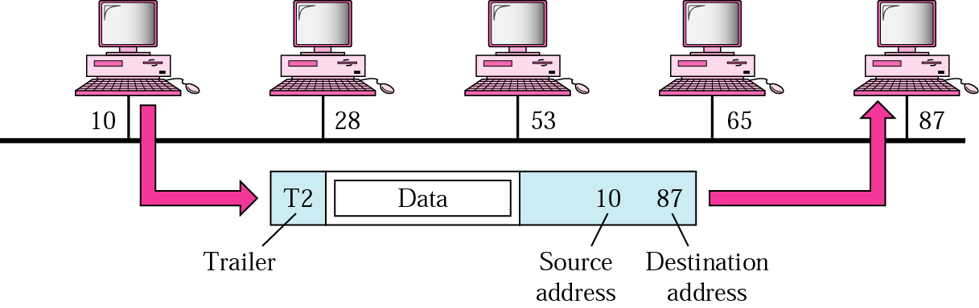
Example 1
In following Figure a node with physical address 10 sends a frame to a node with physical address 87. The two nodes are connected by a link. At the data link level this frame contains physical addresses in the header. These are the only addresses needed. The rest of the header contains other information needed at this level. The trailer usually contains extra bits needed for error detection
1.<number>

Slide 43
Network Layer
The network layer is responsible for the
delivery of individual packets from
the source host to the destination host.
Source-to-destination delivery
Responsible from the delivery of packets from the original source to the final destination
Functions
  Logical addressing
  routing
1.<number>

Slide 44

Network layer
1.<number>

Slide 45

Source-to-destination delivery
1.<number>

Slide 46
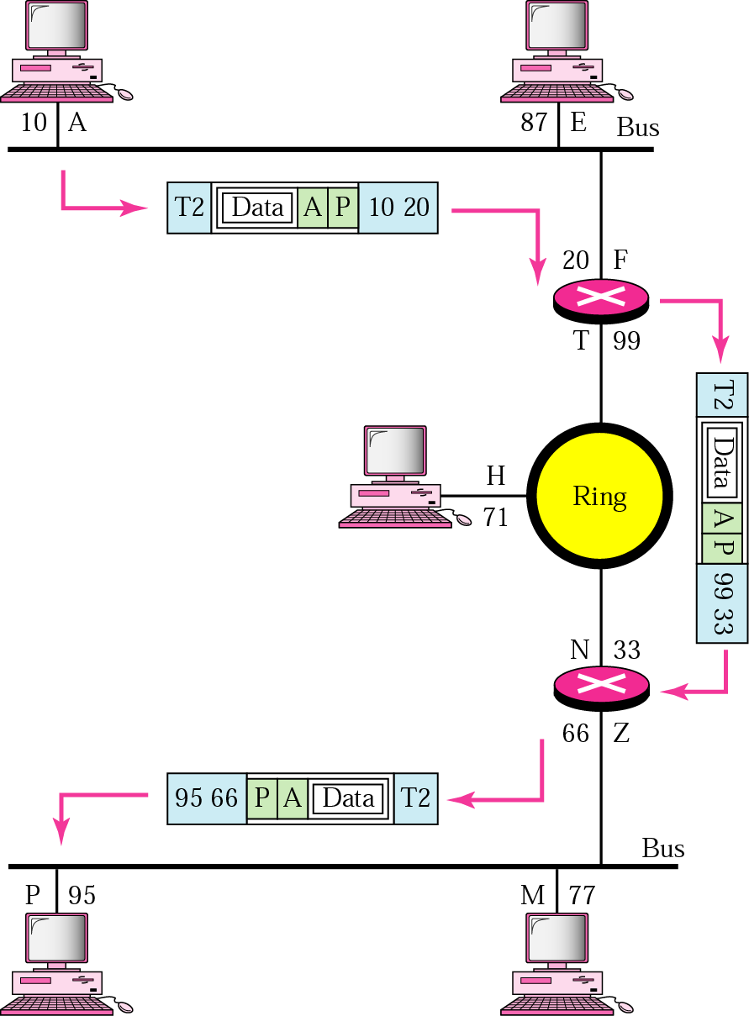
Example 2
We want to send data from a node with network address A and physical address 10, located on one LAN, to a node with a network address P and physical address 95, located on another LAN. Because the two devices are located on different networks, we cannot use physical addresses only; the physical addresses only have local influence. What we need here are universal addresses that can pass through the LAN boundaries. The network (logical) addresses have this characteristic.
1.<number>

Slide 47
Transport Layer
The transport layer is responsible for the delivery
of a message from one process to another.
Process-to- process delivery
Functions
  Port addressing
  Segmentation and reassembly
  Connection control ( Connection-oriented or connection-less)
  Flow control
  Error control
1.<number>

Slide 48

Transport layer
Segmentation and reassembly
1.<number>

Slide 49

Reliable process-to-process delivery of a message
1.<number>

Slide 50
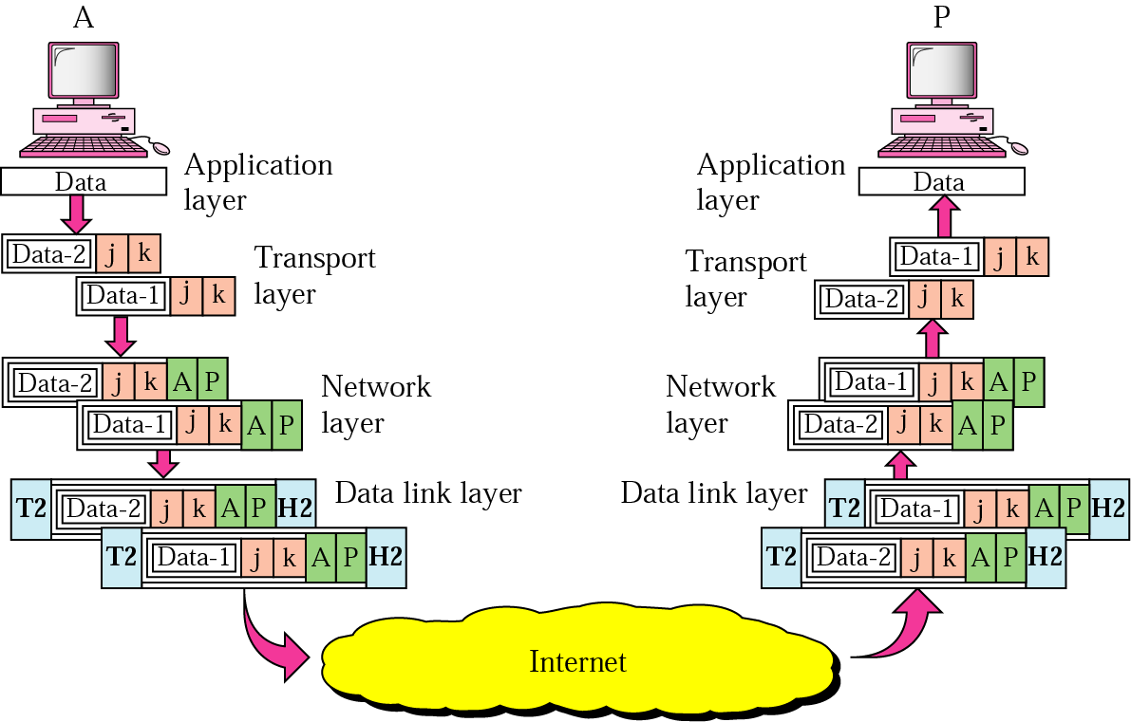
Example 3
Data coming from the upper layers have port addresses j and k (j is the address of the sending process, and k is the address of the receiving process). Since the data size is larger than the network layer can handle, the data are split into two packets, each packet retaining the port addresses (j and k). Then in the network layer, network addresses (A and P) are added to each packet.
1.<number>

Slide 51
Session Layer
The session layer is responsible for dialog
control and synchronization.
  It establishes, maintains and synchronize the interaction between communicating system
  Function
    Dialog control
    Synchronization (checkpoints)
1.<number>

Slide 52

Session layer
Synchronization
1.<number>

Slide 53
Presentation Layer
The presentation layer is responsible for translation, compression, and encryption.
  Concerned with the syntax and semantics of the information exchanged between two system
  Functions
    Translation ( EBCDIC-coded text file → ASCII-coded file)
    Encryption and Decryption
    Compression
1.<number>

Slide 54

Presentation layer
1.<number>

Slide 55
Application Layer
The application layer is responsible for
providing services to the user.
Functions
  Network virtual terminal (Remote log-in)
  File transfer and access
  Mail services
  Directory services (Distributed Database)
  Accessing the World Wide Web
1.<number>

Slide 56

Application layer
1.<number>

Slide 57

Summary of layers
1.<number>

Slide 58
Summary of layers
OSI Model
 | Data unit | Layer | Function
User support layers | Data | 7. Application | Network process to application
 |  | 6. Presentation | Data representation and encryption
 |  | 5. Session | Inter-host communication
User⬄ Network | Segment | 4. Transport | End-to-end connections and reliability
Network support layers | Packet | 3. Network | Path determination and logical addressing
 | Frame | 2. Data Link | Physical addressing
 | Bit | 1. Physical | Media, signal and binary transmission
Sender
Receiver
1.<number>

Slide 59
Network Models
Lecture 3
TCP/IP Model
1.<number>

Slide 60
1-5.2 TCP/IP PROTOCOL SUITE
The layers in the TCP/IP protocol suite do not exactly match those in the OSI model. The original TCP/IP protocol suite was defined as having four layers: host-to-network, internet, transport, and application. However, when TCP/IP is compared to OSI, we can say that the TCP/IP protocol suite is made of five layers: physical, data link, network, transport, and application.
Topics discussed in this section:
Physical and Data Link Layers
Network Layer
Transport Layer
Application Layer
1.<number>

Slide 61

TCP/IP and OSI model
OSI Model
TCP/IP Model
1.<number>

Slide 62
Internet Layer
TCP/IP support the Internet Protocol IP ( unreliable).
IP is a host-to-host protocol.
Supporting protocols:
Address Resolution Protocol (ARP)
Reverse Address Resolution Protocol (RARP)
Internet Control Massage Protocol (ICMP)
Internet Group Massage Protocol (IGMP)
1.<number>

Slide 63
Transport Layer
Process-to-process protocol.
User Datagram Protocol (UDP)
Transmission Control Protocol (TCP)
Stream Control Transmission Protocol (SCTP)
1.<number>

Slide 64
1-6 ADDRESSING
Four levels of addresses are used in an internet employing the TCP/IP protocols: physical, logical, port, and specific.
Topics discussed in this section:
Physical Addresses
Logical Addresses
Port Addresses
Specific Addresses
1.<number>

Slide 65

Addresses in TCP/IP
1.<number>

Slide 66

Relationship of layers and addresses in TCP/IP
1.<number>

Slide 67
Physical Address
Physical addresses are imprinted on the NIC. Most local-area networks (Ethernet) use a 48-bit (6-byte) physical address written as 12 hexadecimal digits; every byte (2 hexadecimal digits) is separated by a colon.
Example:
07:01:02:01:2C:4B
A 6-byte (12 hexadecimal digits) physical address.
1.<number>

Slide 68
Physical Address
known also as the MAC address
Is the address of a node as defined by its LAN or WAN
It is included in the frame used by data link layer
The physical addresses in the datagram may change from hop to hop.
1.<number>

Slide 69
Logical Address
IP addresses are necessary for universal communications that are independent of physical network.
No two host address on the internet can have the same IP address
IP addresses in the Internet are 32-bit address that uniquely define a host.
The physical addresses will change from hop to hop,
but the logical addresses usually remain the same.
1.<number>

Slide 70
Port addresses
Port address is a 16-bit address represented by one decimal number ranged from (0-65535) to choose a process among multiple processes on the destination host.
Destination port number is needed for delivery.
Source port number is needed for receiving a reply as an acknowledgments.
In TCP/IP , a 16-bit port address represented
as one single number. Example: 753
The physical addresses change from hop to hop,
but the logical and port addresses usually remain the same.
1.<number>

Slide 71

Port addresses
1.<number>

Slide 72
Specific addresses
E-mail address (user1@ksu.edu.sa)
Universal Resource Locator (URL) (www.ksu.edu.sa)
The Domain Name System (DNS) translates human-friendly computer hostnames ( URL) into IP addresses. For example, www.example.com is translated to 208.77.188.166
1.<number>

